Slide 1



Sixth Semester
Engineering Economics
HSS-4002
Lecture 02
Lidwin Kenneth Michael,
Faculty, Dept. of Humanities and Management,
Manipal Institute of Technology - Manipal

Slide 2

Fundamental Economic Concepts
Producer and consumer goods
Factors of production
Law of Demand
Law of Supply

Slide 3
Producer and Consumer Goods
Consumer Goods
Consumer goods are the goods and services that directly satisfy human wants.
Ex: Television sets, Bread, Milk etc.
Producer Goods
Producer goods are the goods and services that satisfy human wants indirectly as a part of production or construction process.
They are required for producing other goods.
Ex: Machines, steel, tools etc.
The demand for these goods are derived from consumer goods.

Slide 4
Factors of Production
An Economic term to describe the inputs that are used in the production of goods and services in an attempt to make an economic profit.
The factors of production include:
Land
Labor
Capital
Entrepreneurship

Slide 5
Factors of Production
Land: Includes resources such as minerals, oil, wood etc.
Labor: Includes the skill of those who work, as well as the quantity of people who are available for work.
Capital: It is the money invested into the business such as machinery, buildings etc.
Enterprise: This is the ability to combine other factors of production and to use them profitably to produce goods and services.

Slide 6
Demand Analysis
Demand for a commodity refers to the quantity of the commodity which an individual customer or household is willing to purchase per unit of time at a particular price.
Demand for a commodity implies the following:
Desire of a consumer to buy a product.
Sufficient purchasing power.
Types of demand:
Individual Demand: When we are dealing with a goods demanded by an individual, it is called as individual demand.
Household Demand: If the goods are demanded by the household, then it is said to be household demand.
Individual
Demand
Household
Demand
Market/ Aggregate
Demand

Slide 7
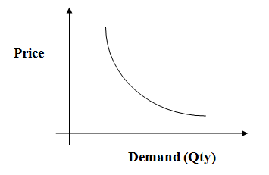
Law of Demand
Law of Demand states that Higher the price lower the quantity demanded and vice versa, other things remaining constant.

Slide 8
Determinants of Demand
The Demand for a product is influenced by:
Price of the Product
Income of the Consumer
Prices of related goods
Substitutes
Complements
Tastes and preferences
Advertisements
Expectations

Slide 9
Exceptions to the law of Demand
Geffen Goods: In the case of Geffen goods or inferior goods, law of demand does not hold good.
ex: Demand for potatoes.
Commodities that are used as status symbols.
Expectations of the change in price of commodity.

Slide 10
Supply
Supply of a commodity refers to various quantities of commodity which a seller is willing and able to sell at different prices in a given market at a point of time, other things remaining same.
Law of Supply
Law of supply states that other things remaining constant, more of a commodity is supplied at higher price and less of it is supplied at lower price.

Slide 11
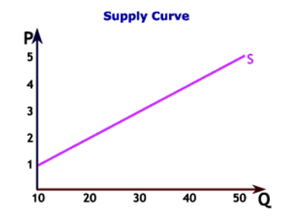
Supply
Determinants of supply:
Price of the good.
Prices of factors of production.
State of Technology.
Producers objectives.

